Slide 1
COMP 3500 Introduction to Operating Systems Synchronization: Part 3 Semaphore
Dr. Xiao Qin
Auburn University http://www.eng.auburn.edu/~xqin
xqin@auburn.edu
Notes:
5 Minutes Lec03a-Process Part 2: slides 16-20
40 Minutes Slides: 16
To present the concept of process synchronization.
To introduce the critical-section problem, whose solutions can be used to ensure the consistency of shared data
To present both software and hardware solutions of the critical-section problem
To examine several classical process-synchronization problems
To explore several tools that are used to solve process synchronization problems

Slide 2
Recap
The test_and_set Instruction
The compare_and_swap Instruction
Bounded-waiting Mutual Exclusion
Notes:
Tips:
Consider target as a lock
Think about two cases: (1) lock is true (locked) (2) lock is false (unlocked)

Slide 3
Mutex Locks
Solve critical section problems using OS
Mutex lock: protect a critical section
acquire() a lock
release() the lock
acquire() and release() must be atomic
This solution requires busy waiting
Notes:
Previous solutions are complicated and generally inaccessible to application programmers
OS designers build software tools to solve critical section problem
Simplest is mutex lock
Protect a critical section by first acquire() a lock then release() the lock
Boolean variable indicating if lock is available or not
Calls to acquire() and release() must be atomic
Usually implemented via hardware atomic instructions
But this solution requires busy waiting
This lock therefore called a spinlock

Slide 4
acquire()
acquire() { while (!available)
; /* busy wait */
available = false;
}
It is locked!
Locked it!

Slide 5
release()
release() {
available = true;
}
do {
acquire lock
critical section
release lock
remainder section
} while (true);

Slide 6
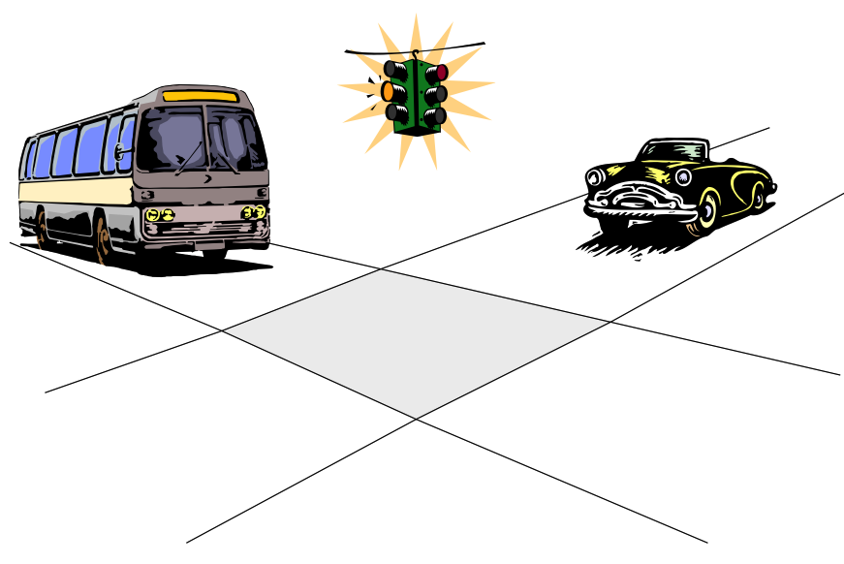
Semaphore
Notes:
History: John Peake Knight is credited with inventing the original traffic light in 1868, a semaphore system based on railway signalling. In 1866, a year in which 1102 people were killed and 1334 injured on roads in London, he proposed a signalling system to regulate the horse-drawn traffic and reduce the number of road accidents.
Invented in the 1960s by Dijkstra
Conceptual OS mechanism, with no specific implementation defined (could be enter()/exit())
Basis of all contemporary OS synchronization mechanisms
The fundamental principle is this: Two or more processes can cooperate by means of simple signals, such that a process can be forced to stop at a specified place until it has received a specific signal. Any complex coordination requirement can be satisfied by the appropriate structure of signals. For signaling, special variables called semaphores are used. To transmit a signal via semaphore s , a process executes the primitive semSignal(s) . To receive a signal via semaphore s , a process executes the primitive semWait(s) ; if the corresponding signal has not yet been transmitted, the process is suspended until the transmission takes place.
To achieve the desired effect, we can view the semaphore as a variable that has an integer value upon which only three operations are defined:
1. A semaphore may be initialized to a nonnegative integer value.
2. The semWait operation decrements the semaphore value. If the value becomes negative, then the process executing the semWait is blocked.
Otherwise, the process continues execution.
3. The semSignal operation increments the semaphore value. If the resulting value is less than or equal to zero, then a process blocked by a semWait operation, if any, is unblocked. Other than these three operations, there is no way to inspect or manipulate semaphores.
We explain these operations as follows. To begin, the semaphore has a zero or positive value. If the value is positive, that value equals the number of processes that can issue a wait and immediately continue to execute. If the value is zero, either by initialization or because a number of processes equal to the initial semaphore value have issued a wait, the next process to issue a wait is blocked, and the semaphore value goes negative. Each subsequent wait drives the semaphore value further into minus territory. The negative value equals the number of processes waiting to be unblocked. Each signal unblocks one of the waiting processes when the semaphore value is negative.

Slide 7
Semaphore
Semaphore S: integer variable
Two atomic operations
wait() and signal()
Also called P() and V()
Counting semaphore – integer value can range over an unrestricted domain
Binary semaphore – integer value can range only between 0 and 1
Same as a mutex lock
Notes:
Synchronization tool that provides more sophisticated ways (than Mutex locks) for process to synchronize their activities.
Semaphore S – integer variable
Can only be accessed via two indivisible (atomic) operations
wait() and signal()
Originally called P() and V()
Definition of the wait() operation
wait(S) {
while (S <= 0)
; // busy wait
S--;
}
Definition of the signal() operation
signal(S) {
S++;
}

Slide 8


Counting vs. Binary Semaphore
Binary semaphore – integer value can range only between 0 and 1
Same as a mutex lock
Counting semaphore – integer value can range over an unrestricted domain
Notes:
Synchronization tool that provides more sophisticated ways (than Mutex locks) for process to synchronize their activities.
Semaphore S – integer variable
Can only be accessed via two indivisible (atomic) operations
wait() and signal()
Originally called P() and V()
Definition of the wait() operation
wait(S) {
while (S <= 0)
; // busy wait
S--;
}
Definition of the signal() operation
signal(S) {
S++;
}

Slide 9
wait() and signal()
Q1: Can you explain these operations?
wait(S) {
while (S <= 0)
; // busy wait
S--;
}
signal(S) {
S++;
}
Notes:
Synchronization tool that provides more sophisticated ways (than Mutex locks) for process to synchronize their activities.
Semaphore S – integer variable
Can only be accessed via two indivisible (atomic) operations
wait() and signal()
Originally called P() and V()
Definition of the wait() operation
wait(S) {
while (S <= 0)
; // busy wait
S--;
}
Definition of the signal() operation
signal(S) {
S++;
}

Slide 10
Sample Semaphore Usage
Can solve various synchronization problems
Consider P₁ and P₂ that require S₁ to happen before S₂
Q2: How to use semaphore “sync” on the two processes?
Q3: How to initialize “sync”?
Create a semaphore “sync” initialized to 0
P1:
S₁;
signal(sync);
P2:
wait(sync);
S₂;
Notes:
Must guarantee that no two processes can execute the wait() and signal() on the same semaphore at the same time
Thus, the implementation becomes the critical section problem where the wait and signal code are placed in the critical section
Could now have busy waiting in critical section implementation
But implementation code is short
Little busy waiting if critical section rarely occupied
Note that applications may spend lots of time in critical sections and therefore this is not a good solution
Can implement a counting semaphore S as a binary semaphore

Slide 11
Semaphore Implementation with no Busy waiting
A semaphore: there is an associated waiting queue
Each entry in a waiting queue has two data items:
value (of type integer)
pointer to next record in the list
Two operations:
block – place the process invoking the operation on the appropriate waiting queue
wakeup – remove one of processes in the waiting queue and place it in the ready queue
typedef struct {
int value; struct process *L; } semaphore;

Slide 12
Implementation with no Busy waiting (Cont.)
wait(semaphore *S) {
S->value--;
if (S->value < 0) { add this process to S->list;
block();
}
}
signal(semaphore *S) {
S->value++;
if (S->value <= 0) { remove a process P from S->list;
wakeup(P);
}
}

Slide 13
Summary
Peterson’s Solution
The test_and_set Instruction
The compare_and_swap Instruction
Notes:
Summary of Chapter 5.

